Slide 1
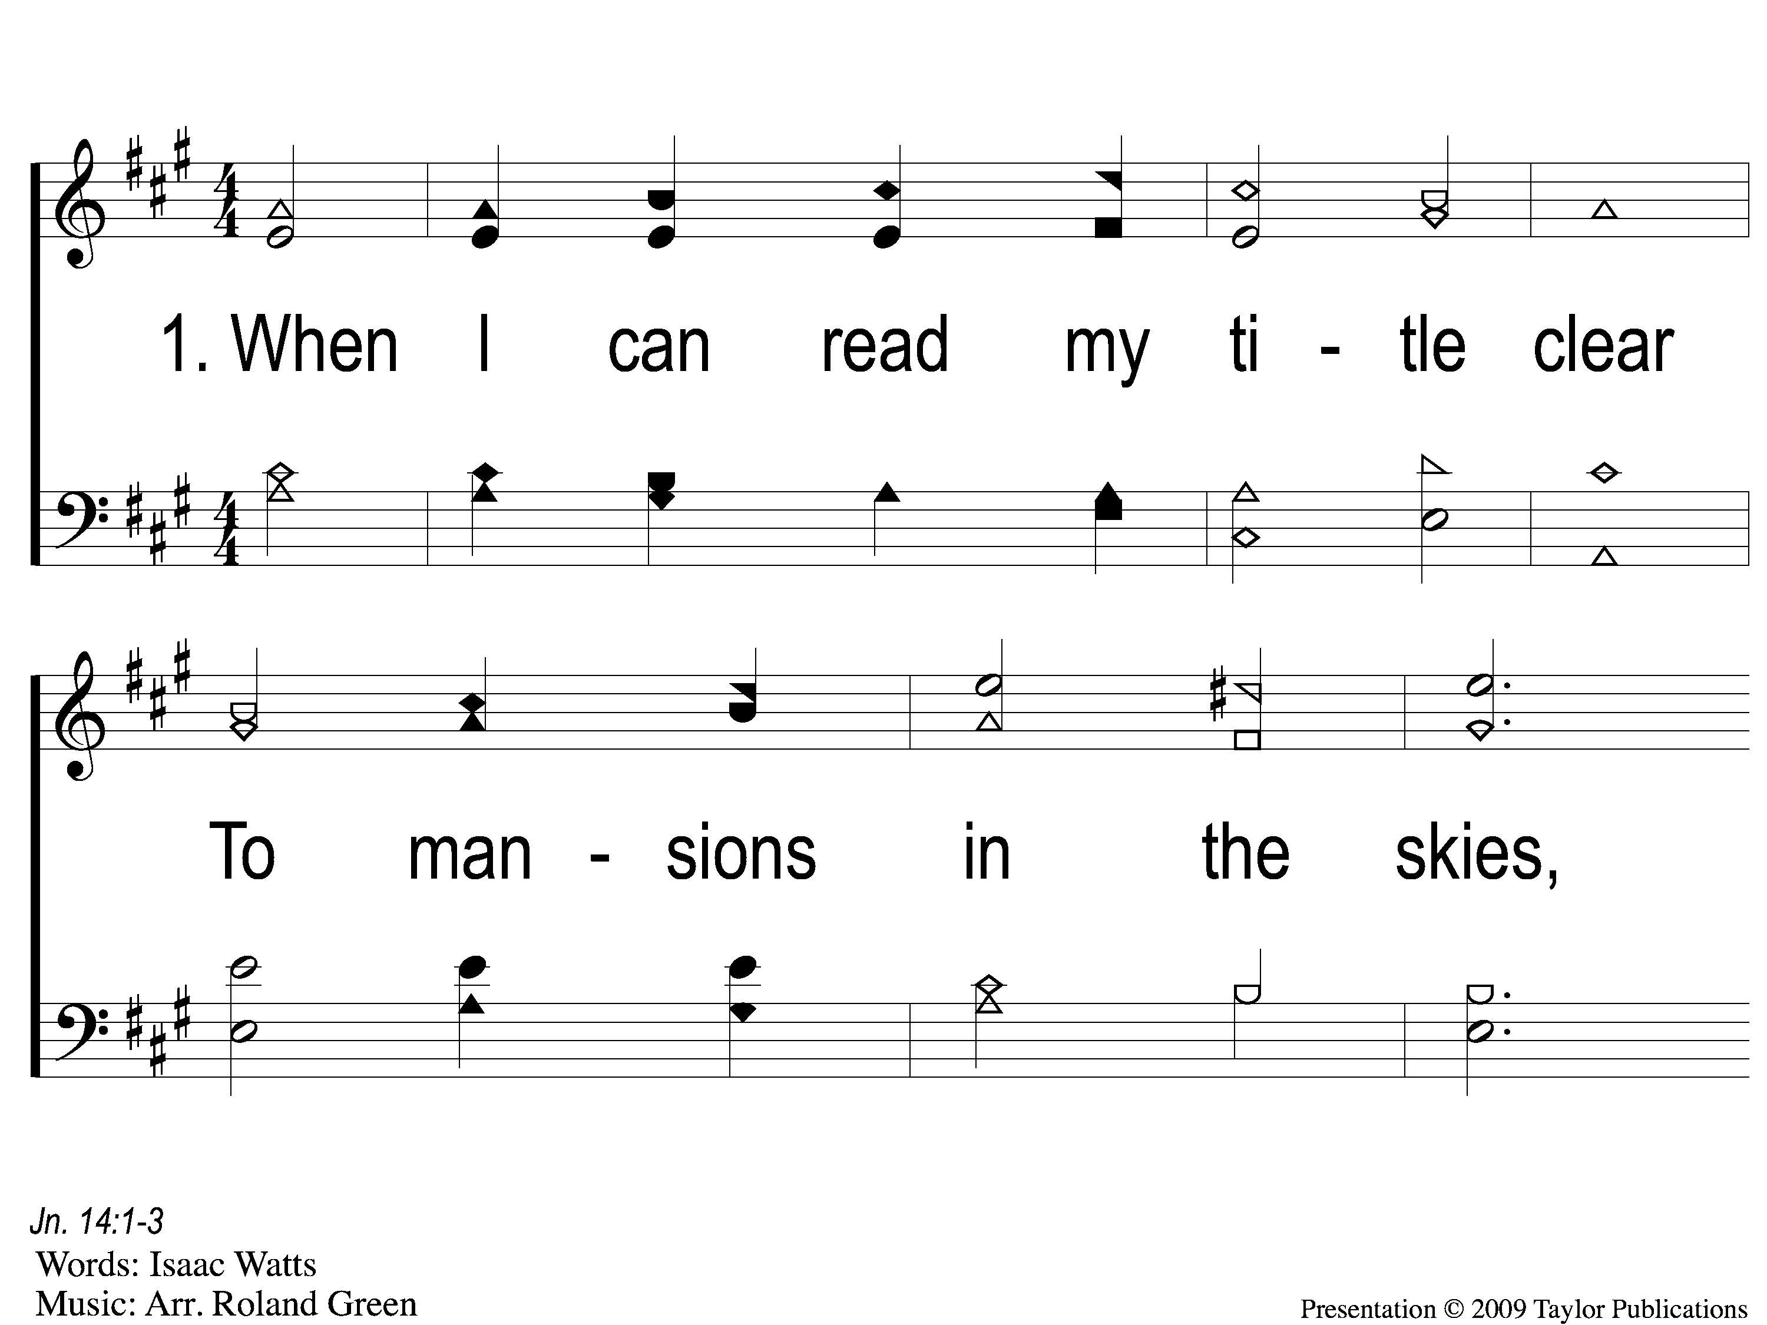
1-1 When I Can Read My Title Clear
When I Can Read My Title Clear
129

Slide 2
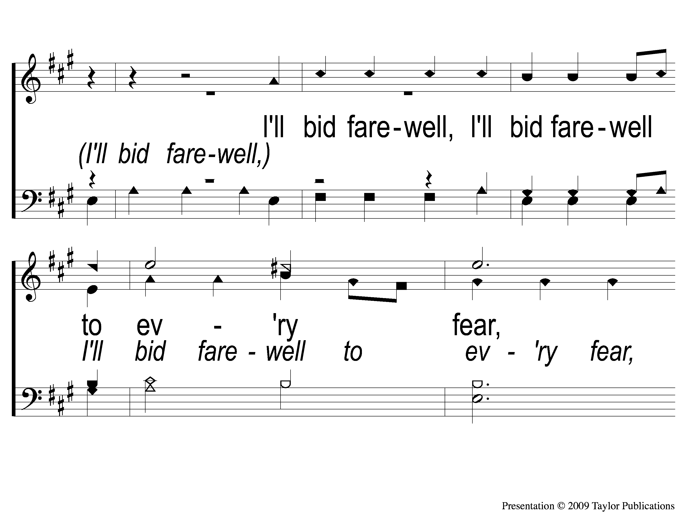
1-2 When I Can Read My Title Clear
When I Can Read My Title Clear
129

Slide 3
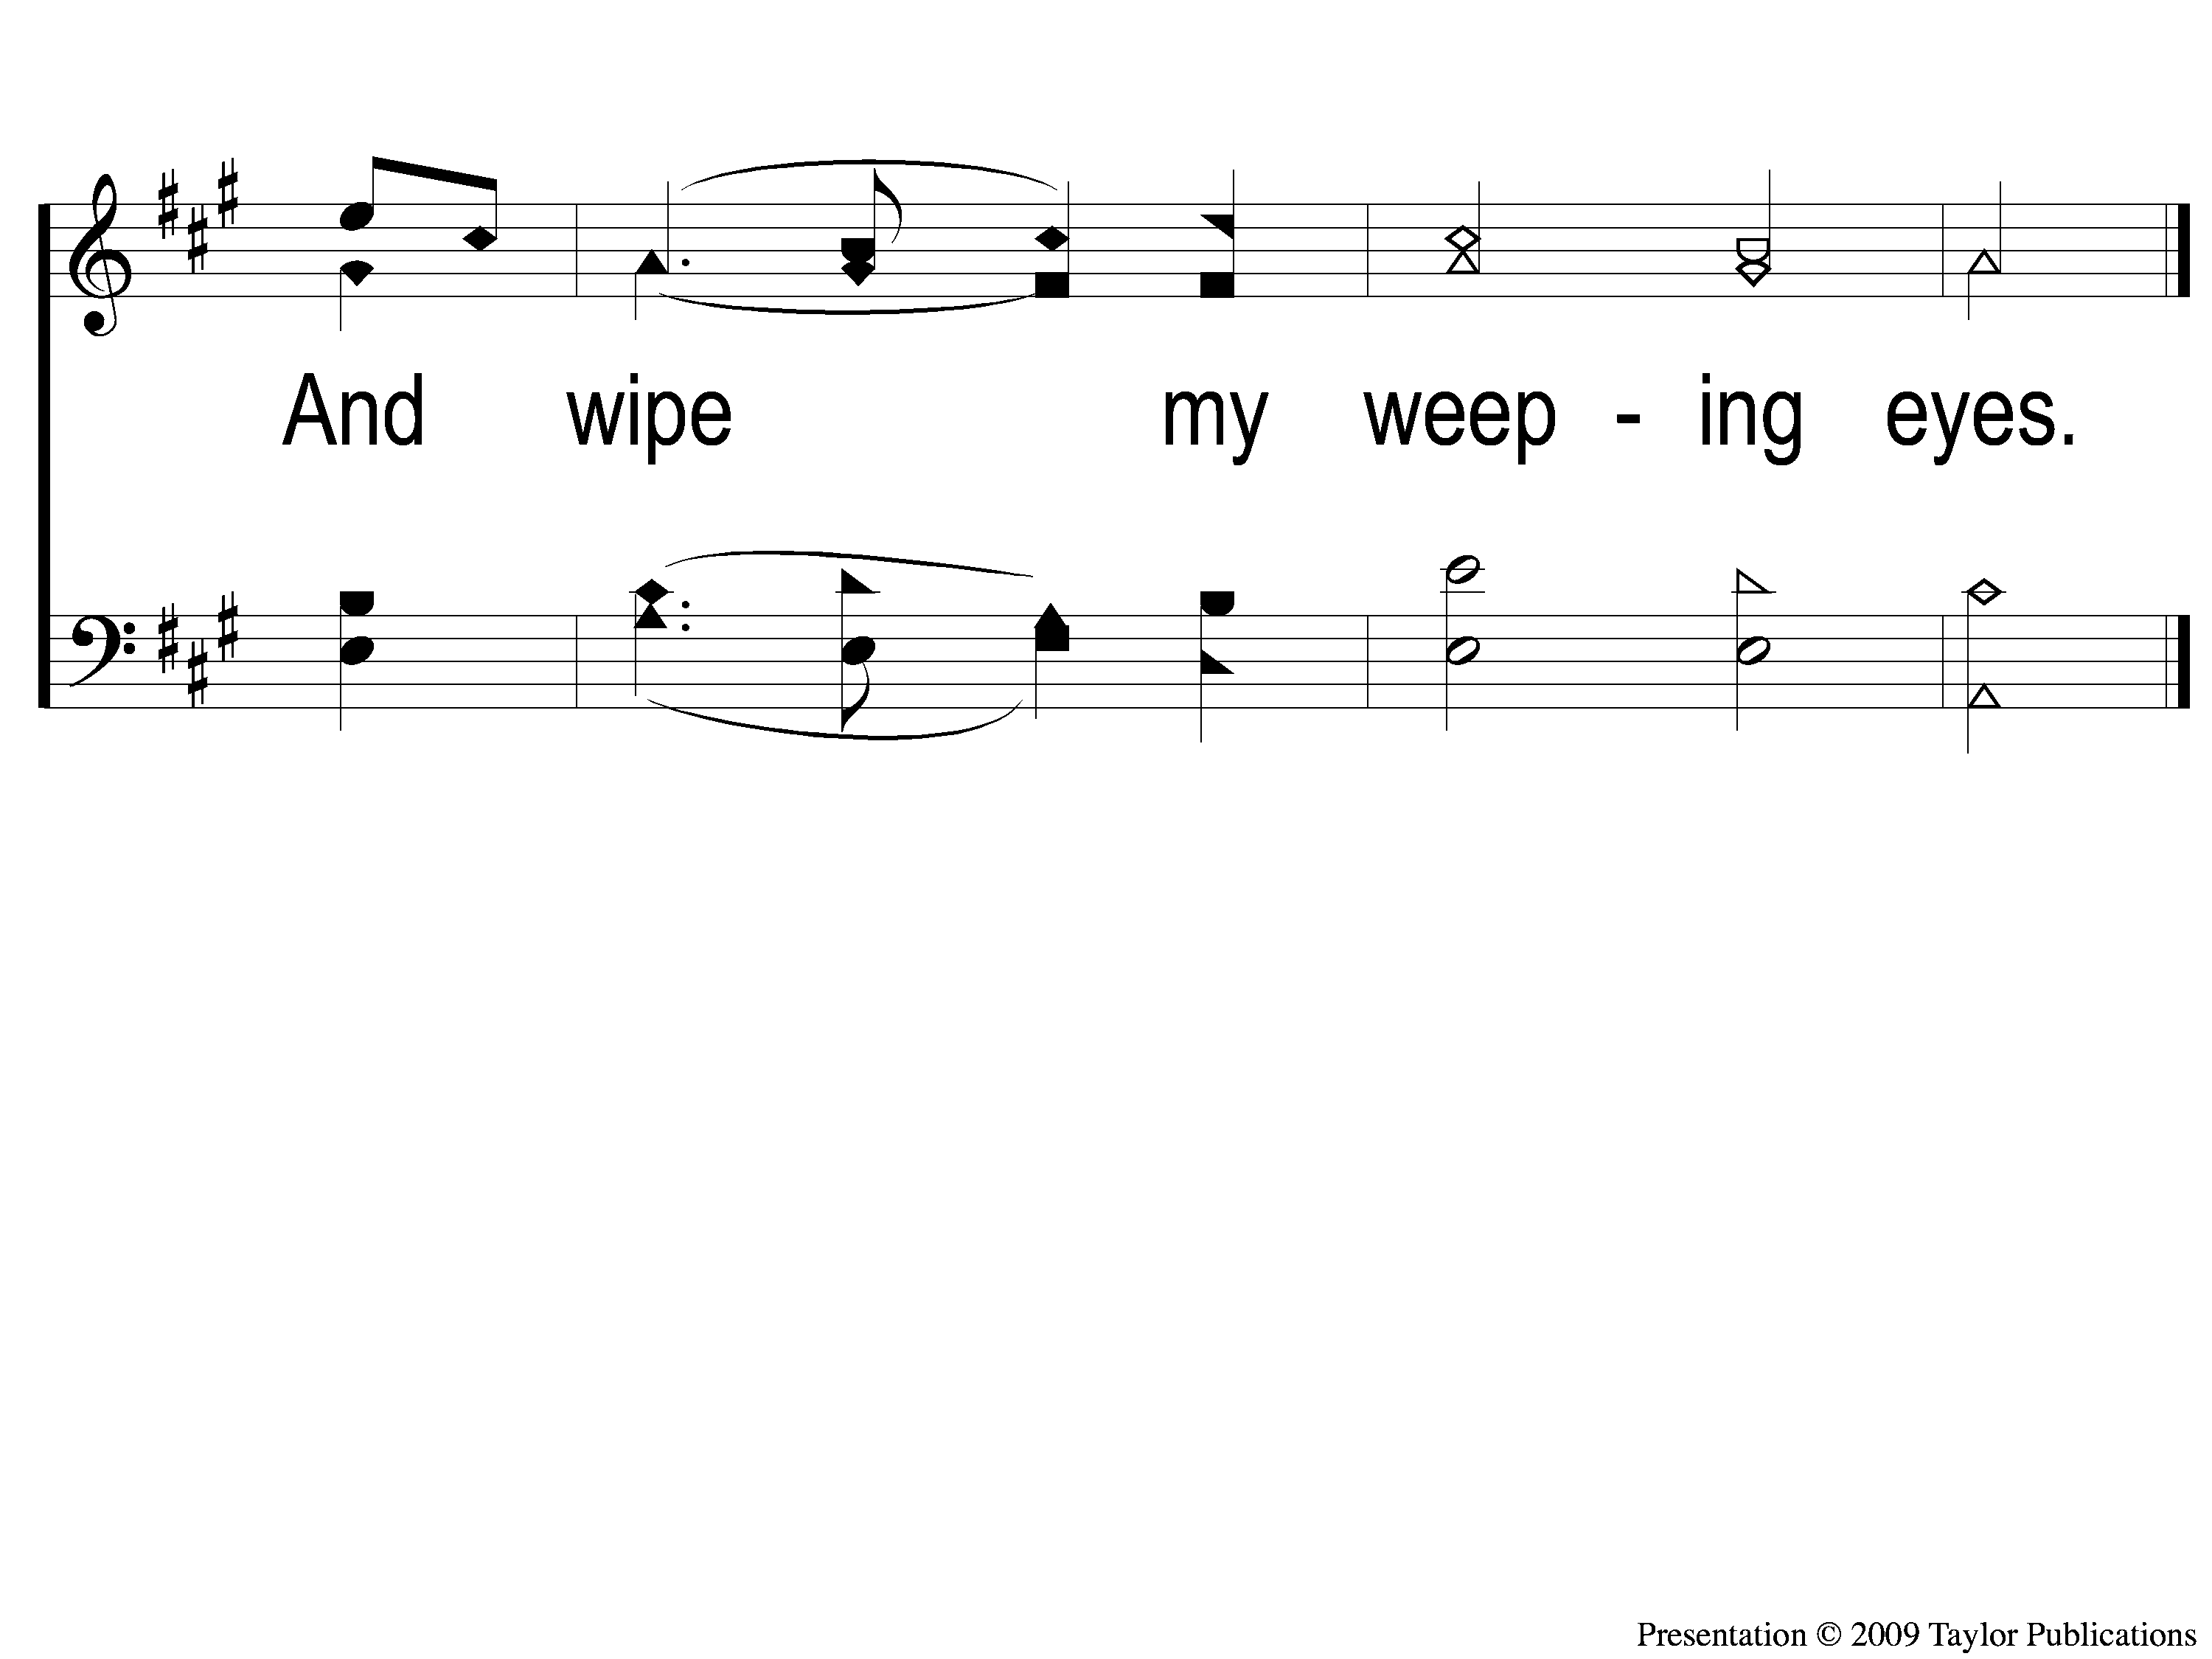
1-3 When I Can Read My Title Clear
When I Can Read My Title Clear
129

Slide 4
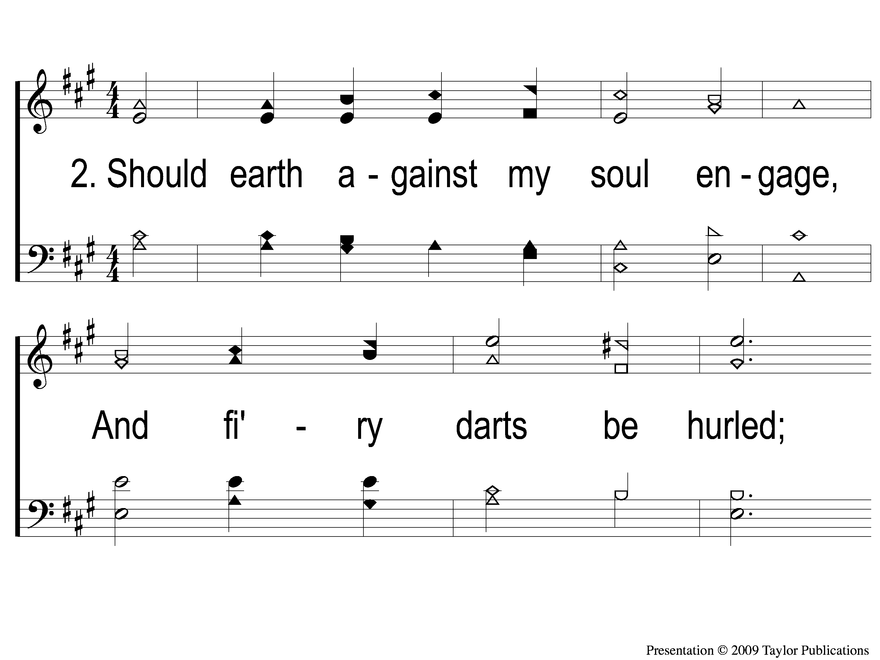
2-1 When I Can Read My Title Clear
When I Can Read My Title Clear
129

Slide 5
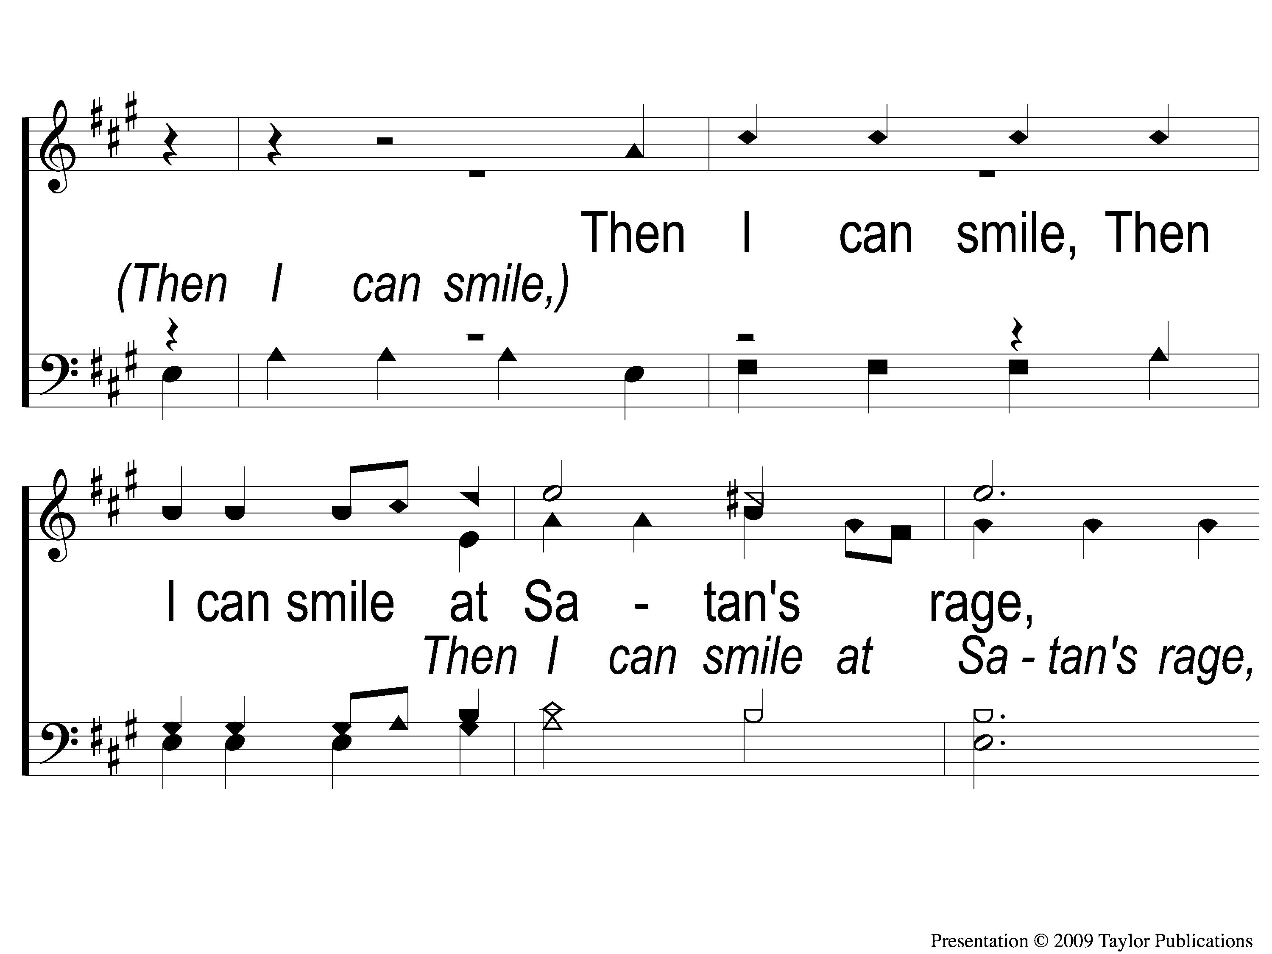
2-2 When I Can Read My Title Clear
When I Can Read My Title Clear
129

Slide 6
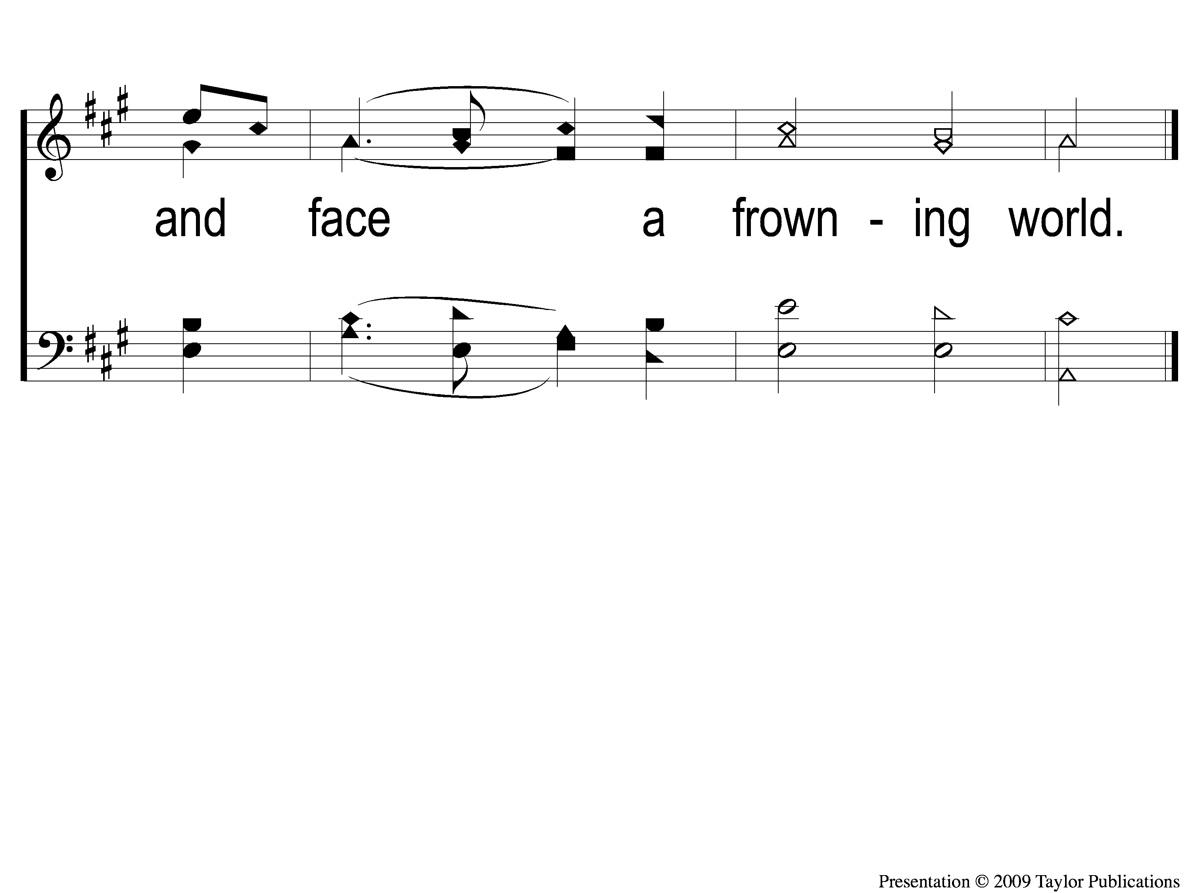
2-3 When I Can Read My Title Clear
When I Can Read My Title Clear
129

Slide 7
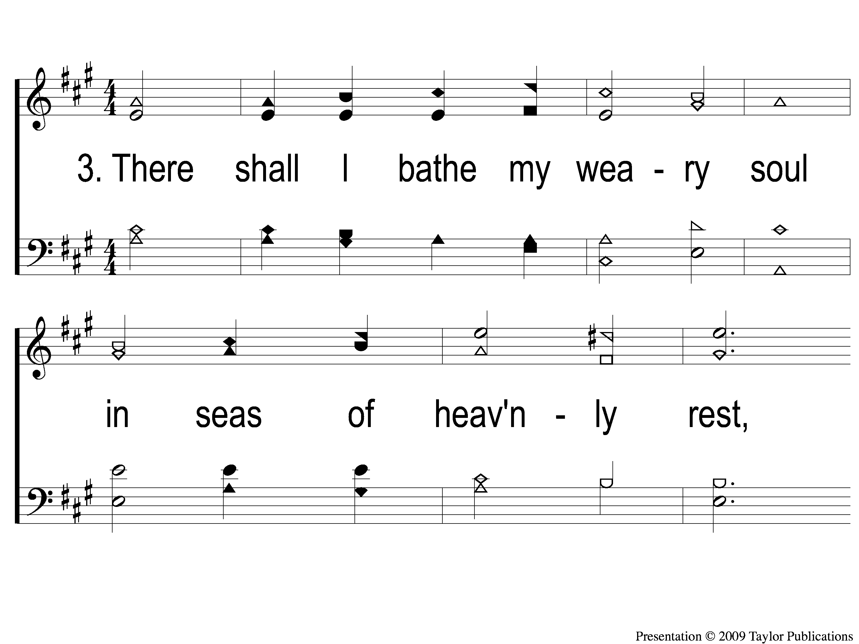
3-1 When I Can Read My Title Clear
When I Can Read My Title Clear
129

Slide 8
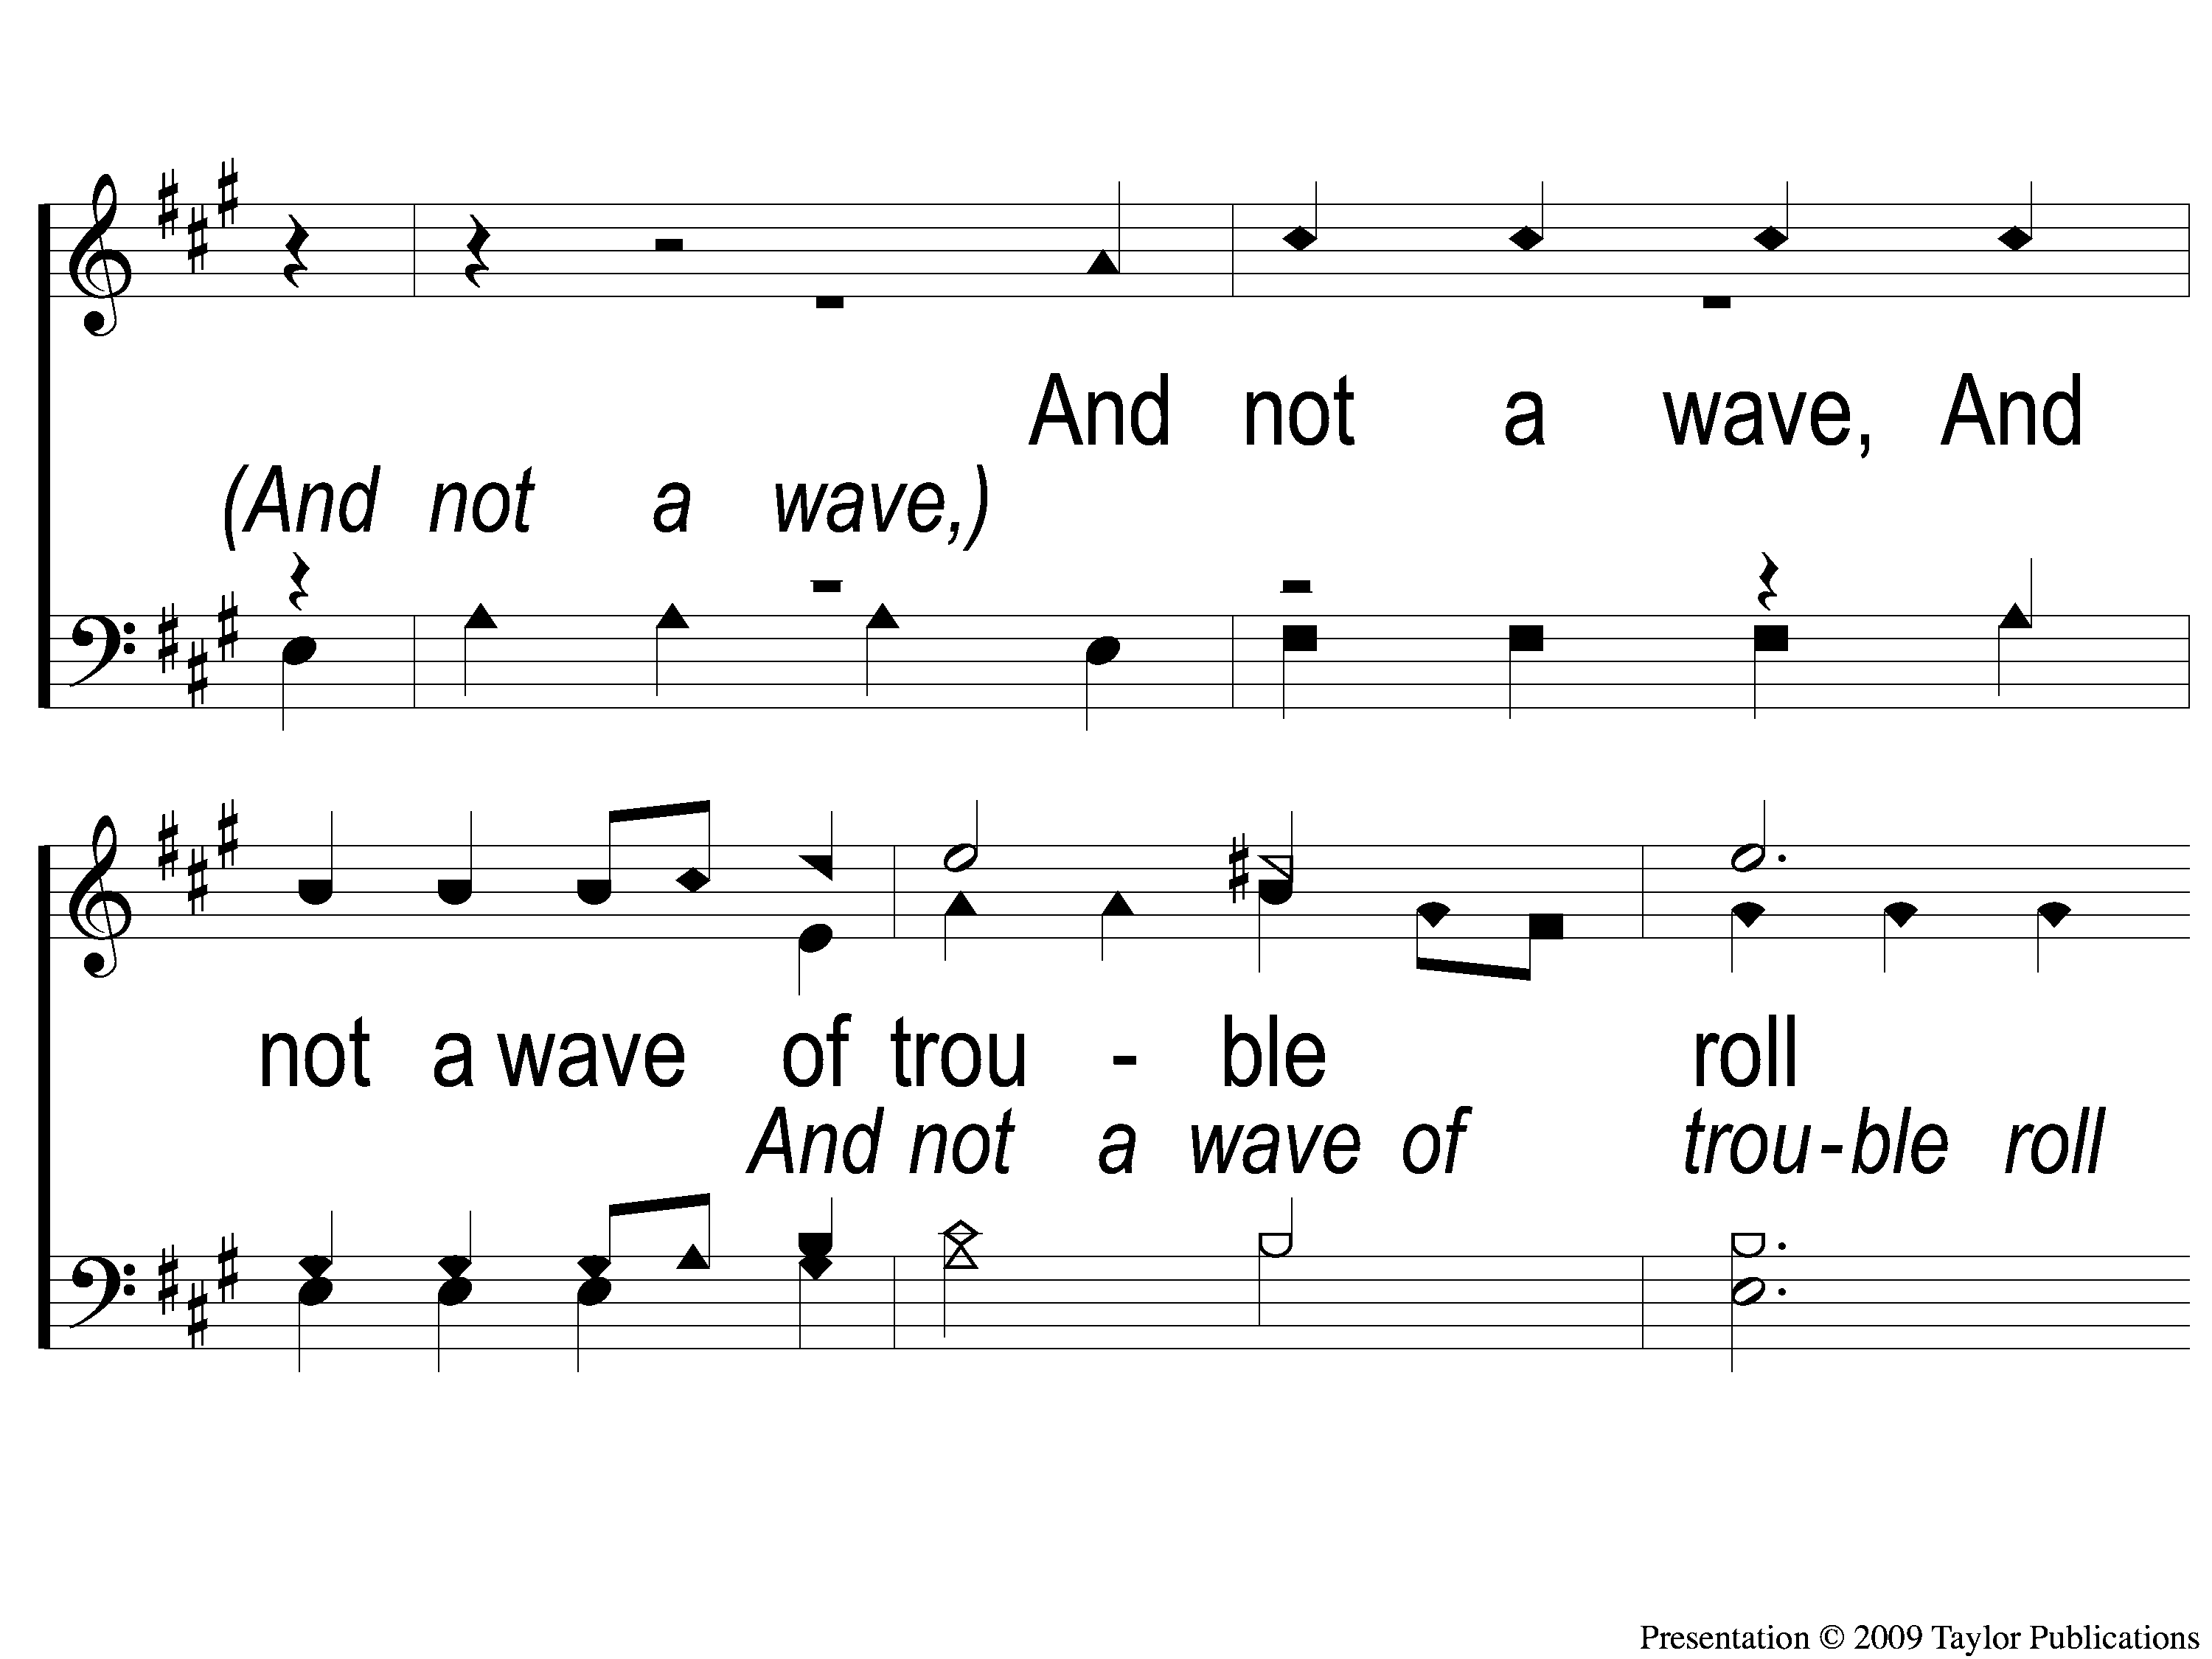
3-2 When I Can Read My Title Clear
When I Can Read My Title Clear
129

Slide 9
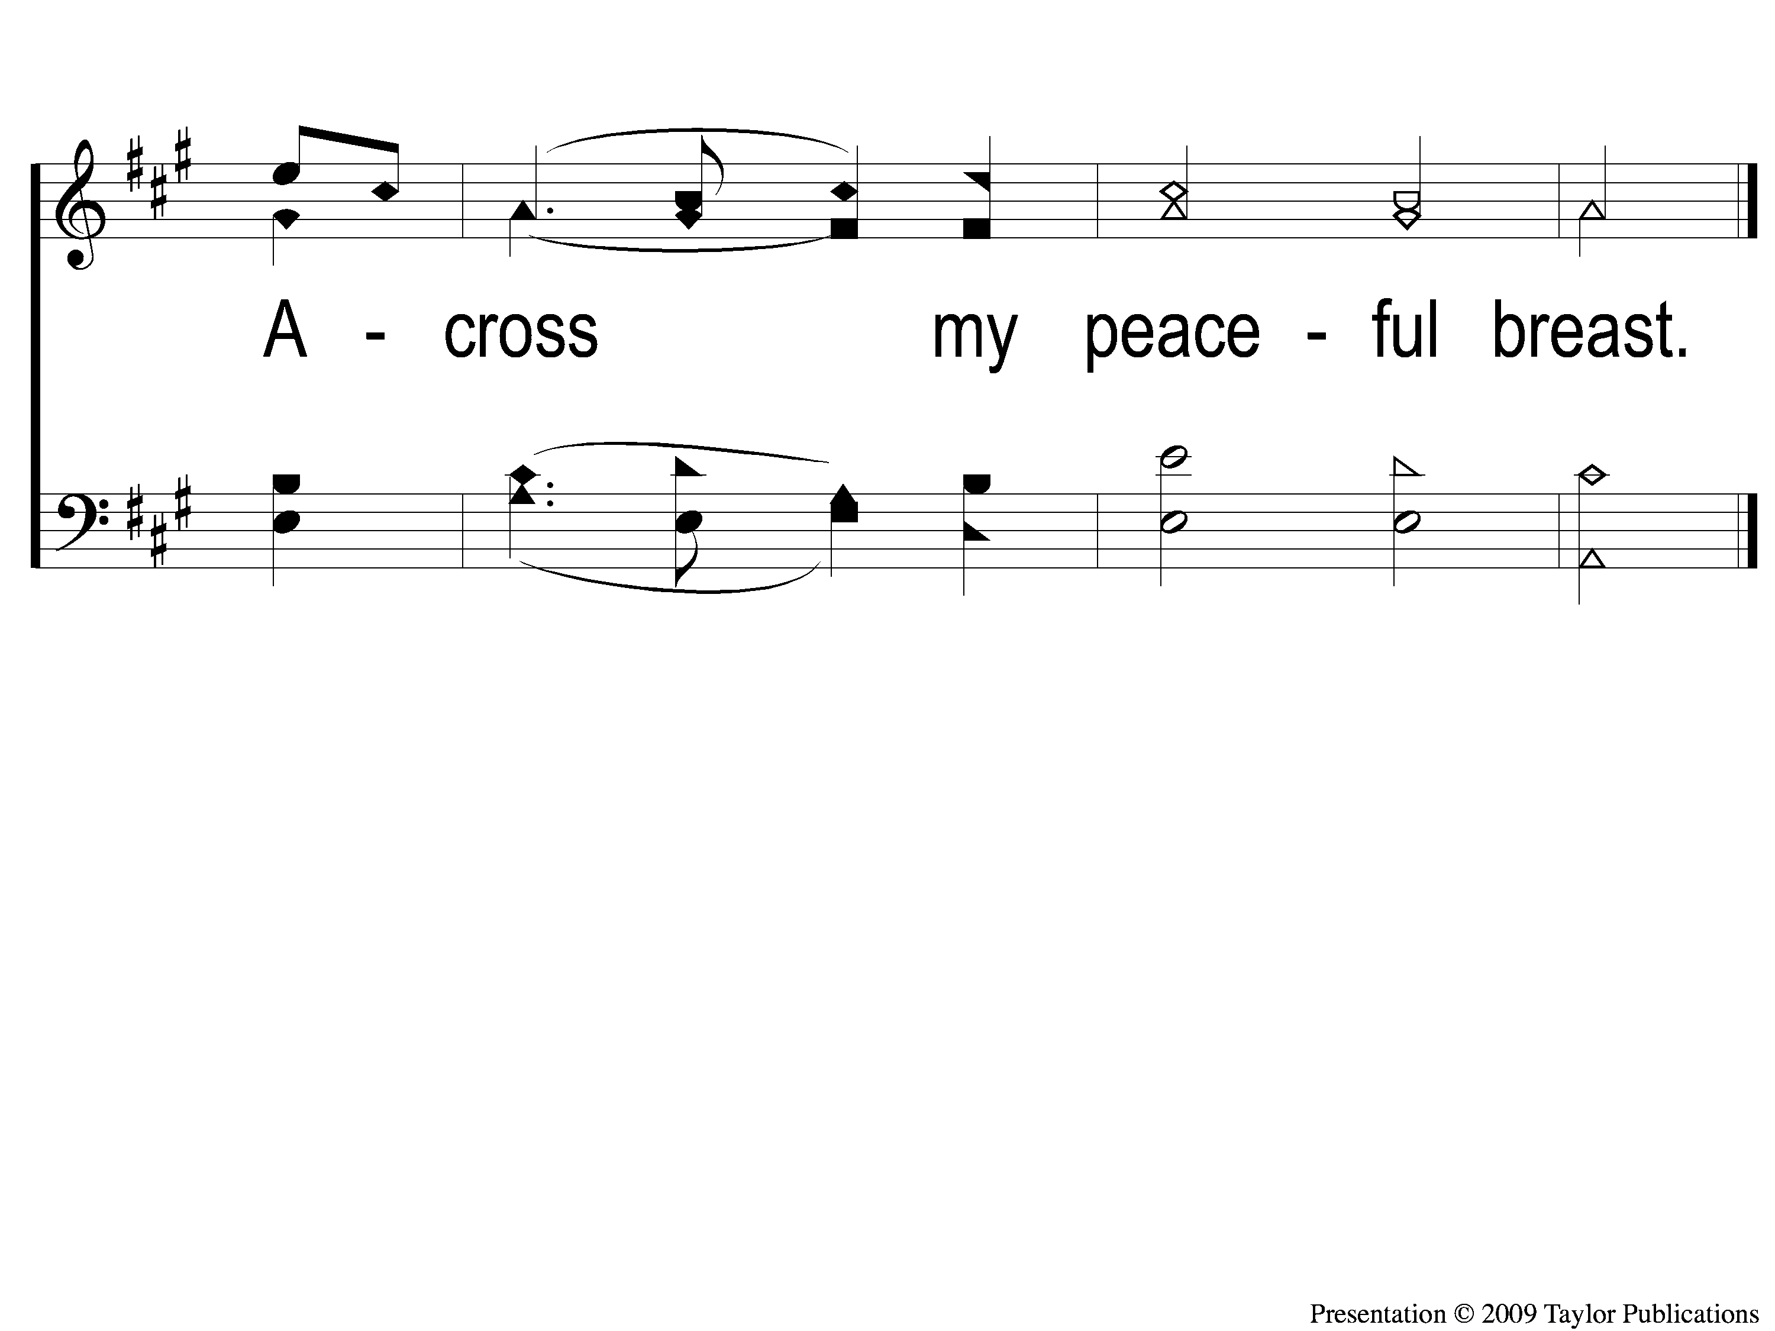
3-3 When I Can Read My Title Clear
When I Can Read My Title Clear
129

